Slide 1
Houses-nests or How to feel like a bird

Slide 2
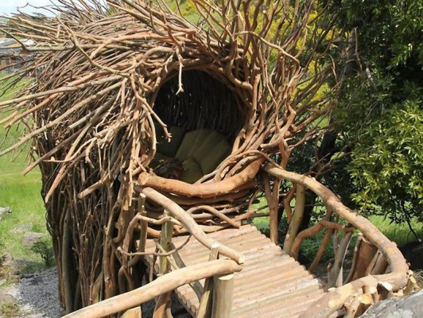

Slide 3
Do You have the desire to someday become a bird? But, fly like birds, we can not, but feel in their place — easily! This unique opportunity gave everyone a Californian artist Jason Fanny, who builds houses-nests for humans.

Slide 4
Here is where you can truly feel like a bird!

Slide 5
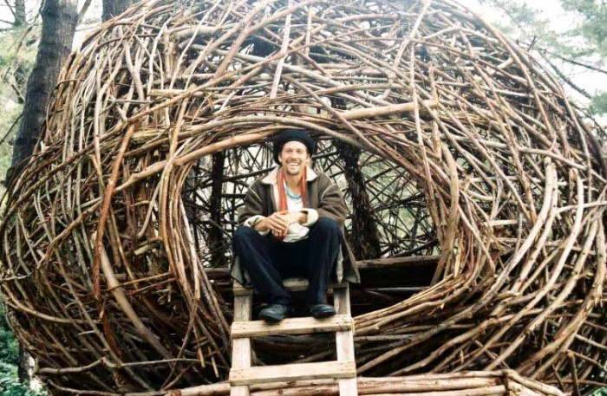

Slide 6
But I warn you, if You love comfort and coziness, sleep in a "hut" — not for You. The nest is not protected against the ingress of water and has no amenities, except for one or two mattresses.

Slide 7
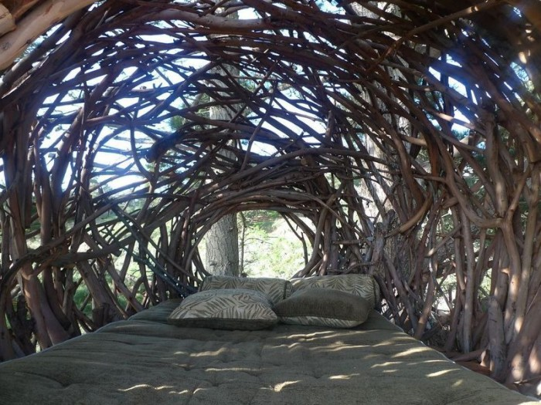

Slide 8
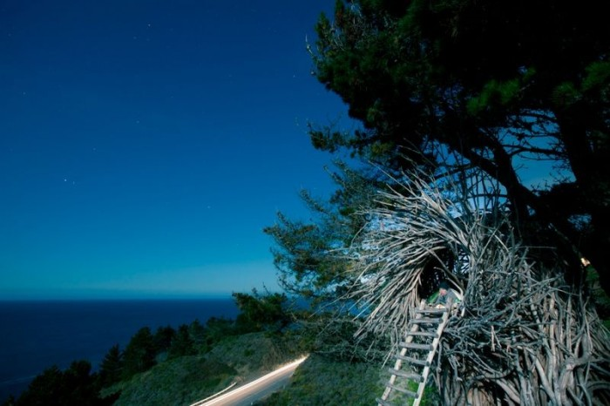

Slide 9
So, if it rains, have to get wet, like the bird in the nest. That's when you can in their own skin to experience all the subtleties of bird life. However, inside the nest you can pitch a tent, prudently brought with them.

Slide 10
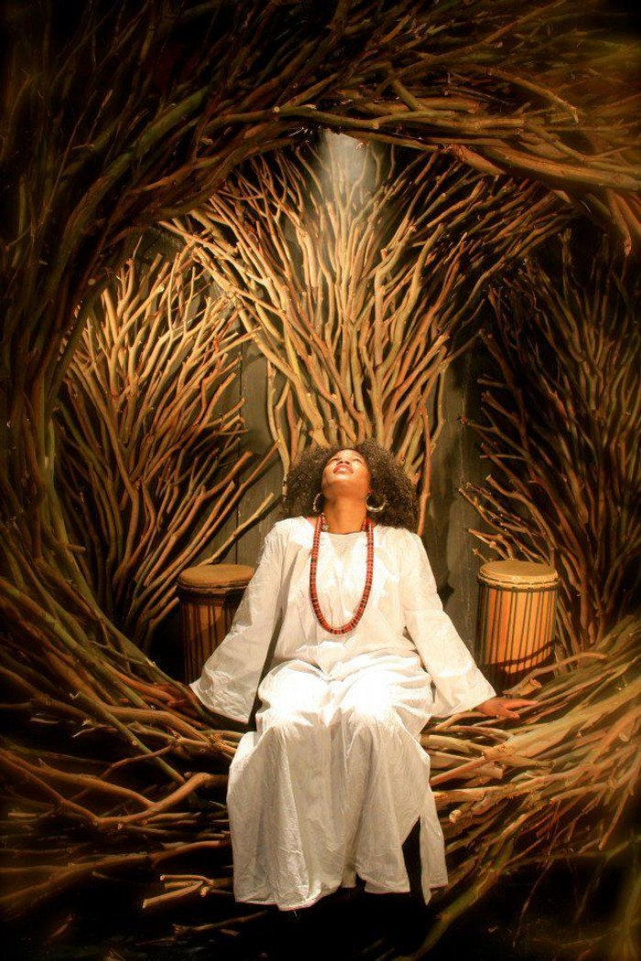

Slide 11
In a nest placed eight people. But Jason was made and such houses, which could accommodate up to 30 people.

Slide 12
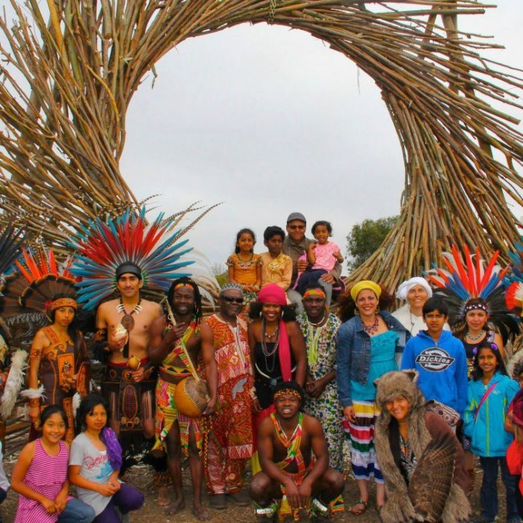

Slide 13
Jason says that values and respects nature, and therefore very carefully collects twigs for their buildings. "First, do no harm to a healthy tree," says the artist.

Slide 14
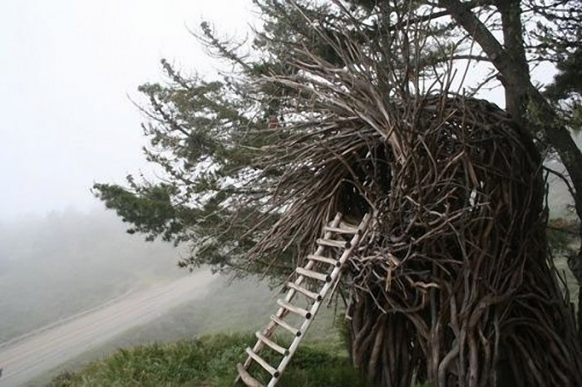

Slide 15
After gathering enough twigs, Fanny goes to work: using a kind of weaving technology, it gradually reduces the nest. And to strengthen structures, uses countersunk screws.

Slide 16
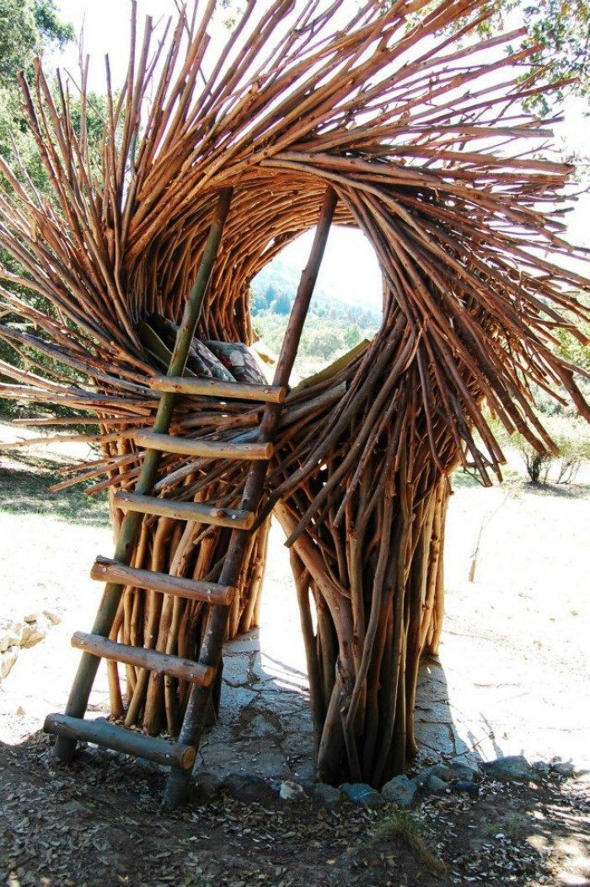

Slide 17
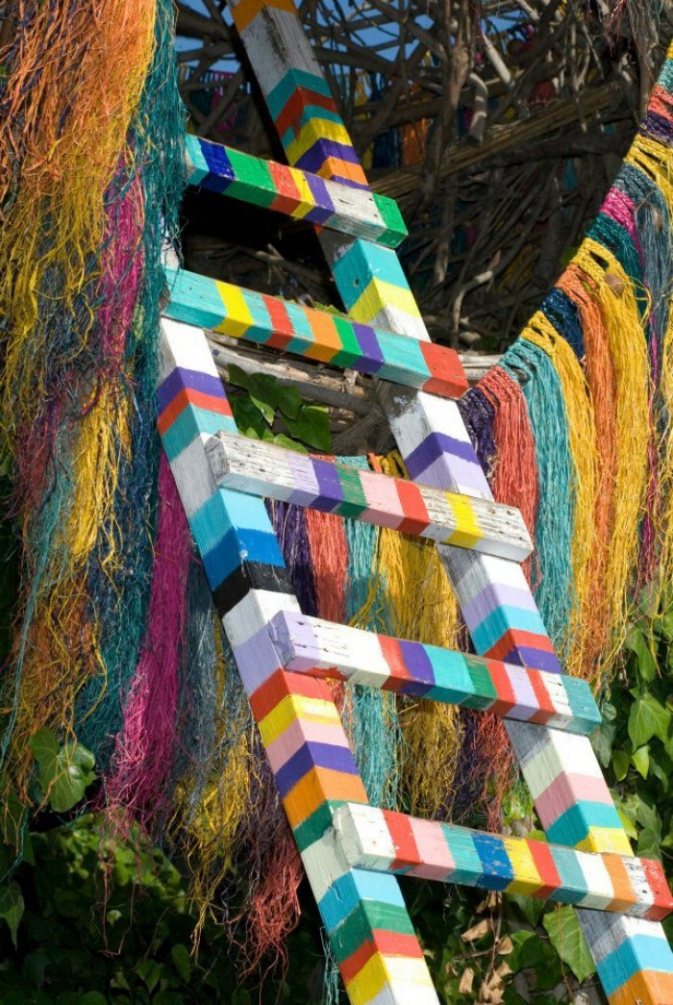

Slide 18
Thanks to unbridled imagination and skillful hands of the artist, in the town of big Sur the coast of Central California is a resort Treebones Resort, where one can rent the nest for people.

Slide 19
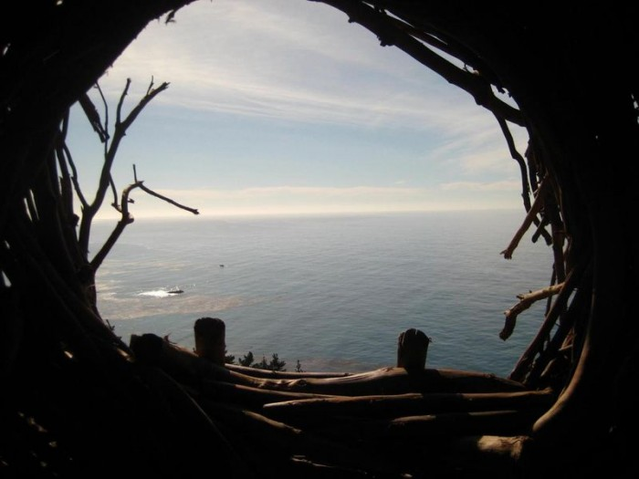

Slide 20
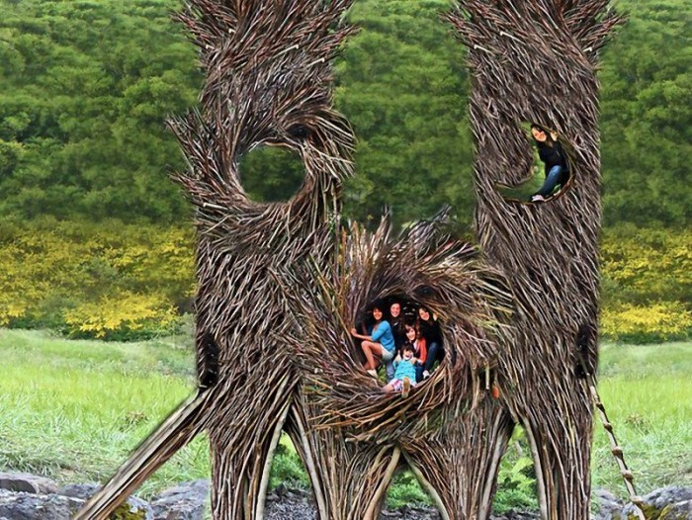

Slide 21
Great idea to have fun and relax in the nest, feeling a real free bird

Slide 22
