Slide 1
Why are teachers important?

Slide 2

There are a lot of interesting and useful professions. The profession of a teacher is a very noble one. A teacher is a very important person for every family where pupils live.

Slide 3
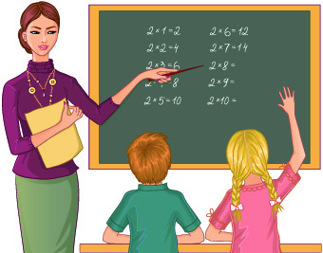
I remember my first teacher very well. Her name is Natalia Mykolaivna. She is a kind and clever woman. She taught us to read and write, told us many interesting things about everything and she instructed us how to work. When we became fifth-formers we have one form-teacher and many other teachers in all school subjects.
My form-teacher’s name is Nina Vasylivna. She is a great teacher who makes learning fun inspiring and stimulating us. She organizes and makes us friendly very much

Slide 4
Some pupils want to become teachers at school. But I myself do not want to be a teacher because this profession is very difficult. The profession of a teacher demands a great patience to children. I believe that people who teach children must have more time for self-education and must be paid well.

