Slide 1
Journalist

Slide 2
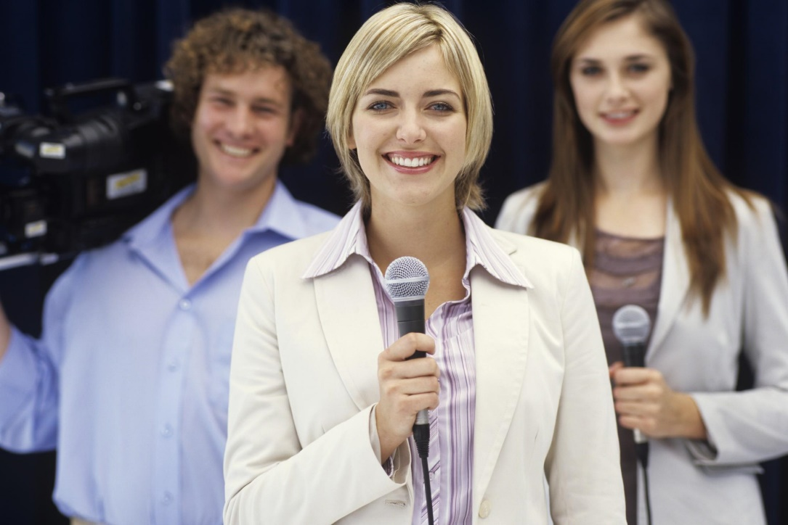
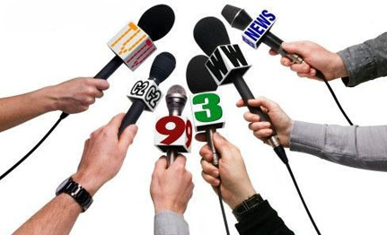
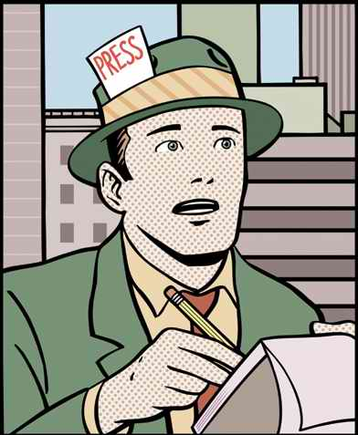
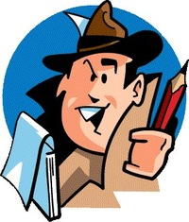

Slide 3
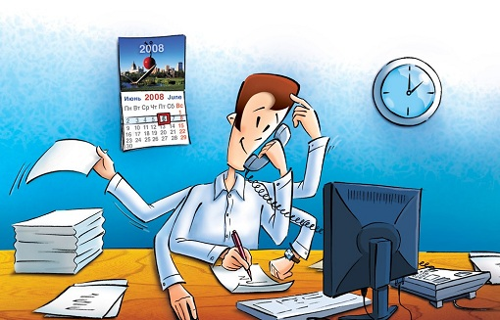
Journalist (reporter) — a person engaged creating, editing, training and registration information. The journalist is the mirror society, it needs to reflect reality.
The vocation of journalist benefit people protect their interests and to make the light in the darkness of ignorance

Slide 4

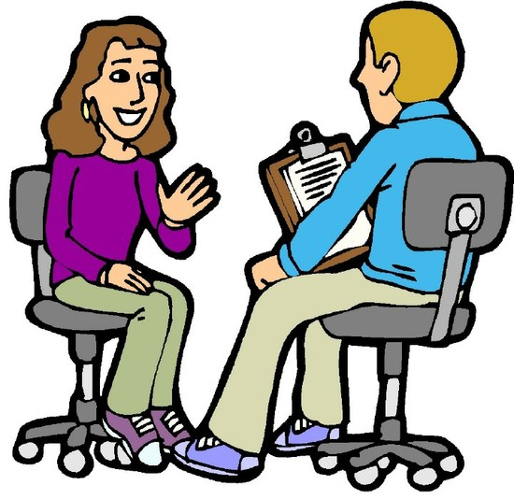
The journalist works for people, talks to them, explores, produces news, predicts the development of events, which in the future will be interesting audience so you must know ethics, and psychology,
Philology, rhetoric, editing and design text, information technology

Slide 5
The content of work work in the media; inform the people with accurate facts; information gathering (interviews, work with documents, archives), its processing; analysis of facts and situations, assessment of events; the search for the most interesting events in economy, politics, culture and public life for their coverage in media; preparation of materials for publication; literary processing of the material based genre identity, stylistic rendering of the facts, journalistic techniques

Slide 6
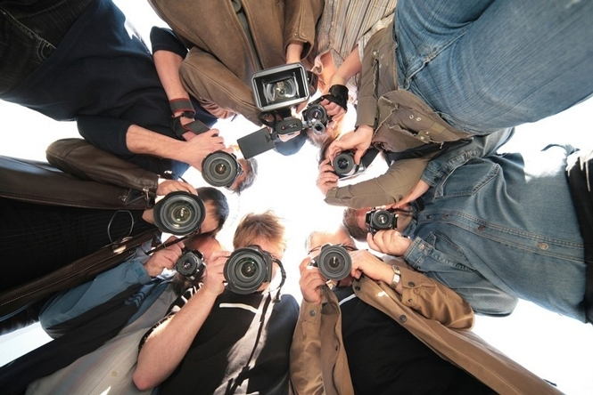
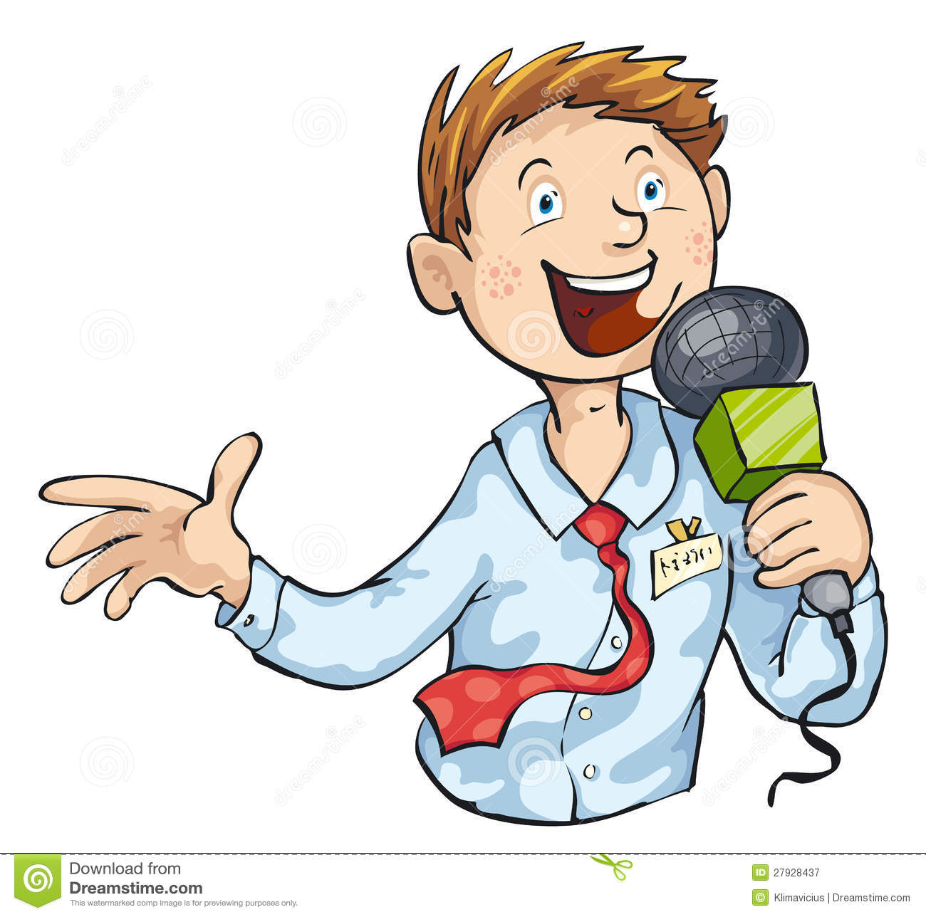
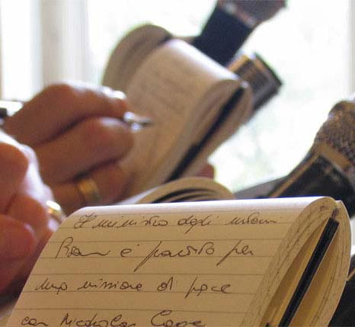

Slide 7
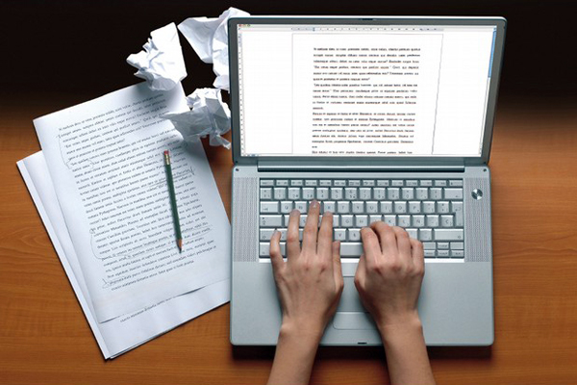
Abilities: communication skills and interaction with people
(making contact) the ability to listen and hear the interlocutor the ability to competently and clearly to ask questions the ability to quickly navigate the events, to take an adequate solution creative thinking

Slide 8
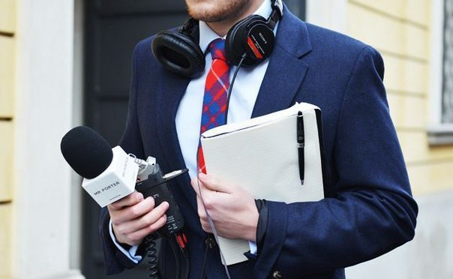
Abilities the ability to present in accessible language obtained information objectivity erudition self-control and poise interest and respect towards another person originality intellectual curiosity, tact, courtesy

Slide 9
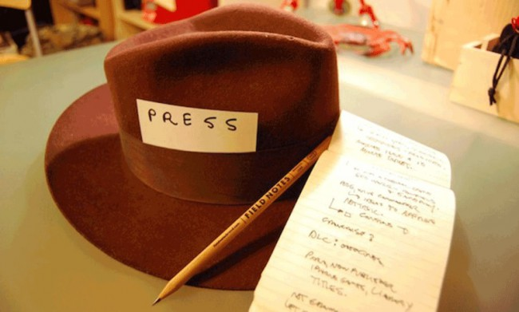
Quality, impeding effectiveness of professional activity: rigidity incommunicability; isolation the inability to properly present information the usefulness dishonesty in the presentation of information

Slide 10
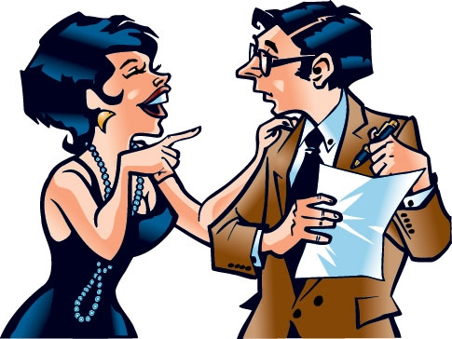
Applications weeklies, Newspapers, magazines, television, radio universities, faculties of journalism

Slide 11
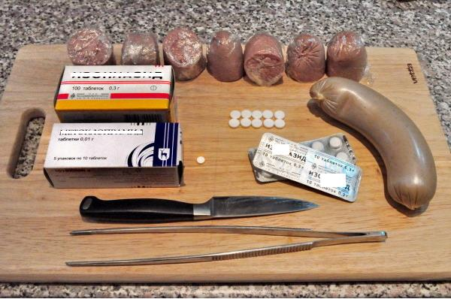
The story of two journalists
Once two journalists given the task. They had to tell about the companies that kill animals. The journalists did not like this job, but they did it. They found a company that kills dogs. They felt sorry for those dogs and they joined the company to work. With this work, they learned that these dog hunters replace the fat in the sausage on the pill and give it to dogs and then kill them. A few tablets can sprinkle the dog. It was good material for the task.
.

Slide 12
Journalists have already thought to leave the job. But they were very sorry for the dogs and they came up with a plan. When dog hunters will go looking for dogs journalists will go with them and when the dog hunters will be given a sausage quickly replaces it with a real one. The plan worked. So journalists have saved many dogs from death. And when their story about the dog hunters appeared in the newspaper, journalists has gained great popularity and not legitimate dog hunters exposed, and instead began to work another company that instead of killing were taken animals to vet and then to the animals stores.

Slide 13
THE END
Kovnatska Anna
Form 6-A

