Slide 1
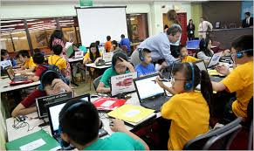
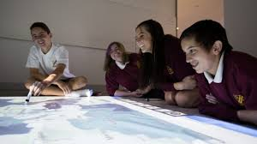


Slide 2
What will our schools look like in 25 years?
In my opinion there will be a lot of unusual technology in the school. Every class room will be equipped with a computer lab and a smart board. We will have on-line lessons in the future. If you are ill, you will have an opportunity to be present at the lesson. One thing we can say for certain is that long-distance studies will become the norm.There will be less subjects than we have now. I think Ipads can be used to replace textbooks. There will be no teachers and no books in the future. Robots and other gadgets will be used for education. This way of teaching students will soon be implemented in every school around the world. Teachers will just help us to get information for studying.
I dream to study in the school of the future!

Slide 3
